Slide 1
Crime Data Analysis
Prepared by:
Arun Kodnani
Vaibhav Lodha
Vatsal Shah

Slide 2
Project Goal
To understand trends in crime across United States.
(cities: New York, Chicago, Los Angeles)
To understand various tangible factors that might affect crime.
(Weather, Demographics, Budget, Restaurant)

Slide 3
Architecture
Tableau , Google sheets
Zeppelin ,DataBricks,Python(Pandas)
DUMBO (Pyspark,SparkSql,HDFS)
Crime Data (NY,Chicago,LA)
Weather Data
Demographics
Budget

Slide 4
Data Gathering
Crime Data (respective city data portal)
Weather Data (National Oceanic & Atmospheric Administration)
Budget (LA city data portal)
Demographics (city data portal, wiki)
Restaurant (city data portal)

Slide 5
Data Cleaning
Fixing Column Names
Null Values
Unique case number
Date formatting
Date & Time consistency
Crime Description and code

Slide 6
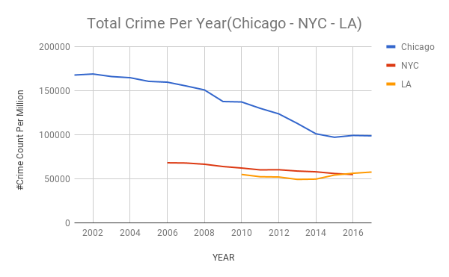
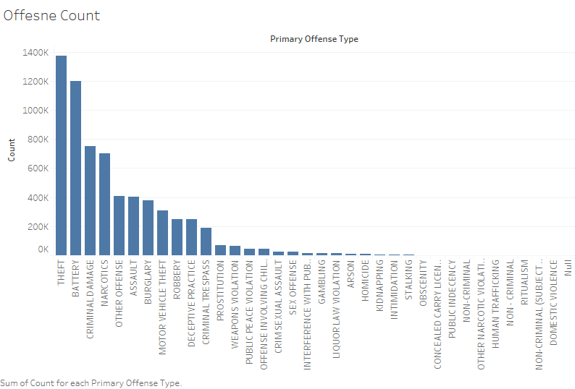
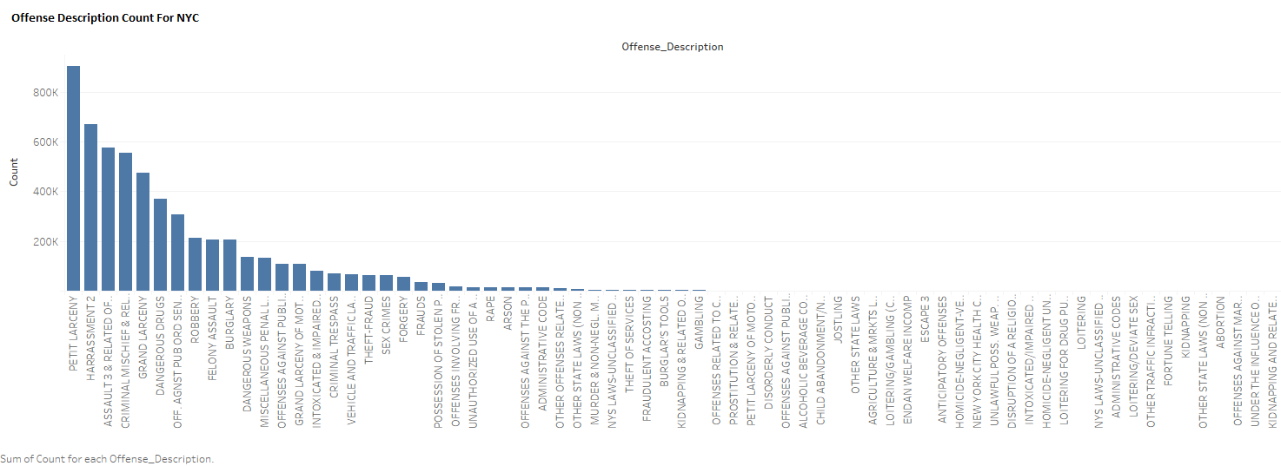
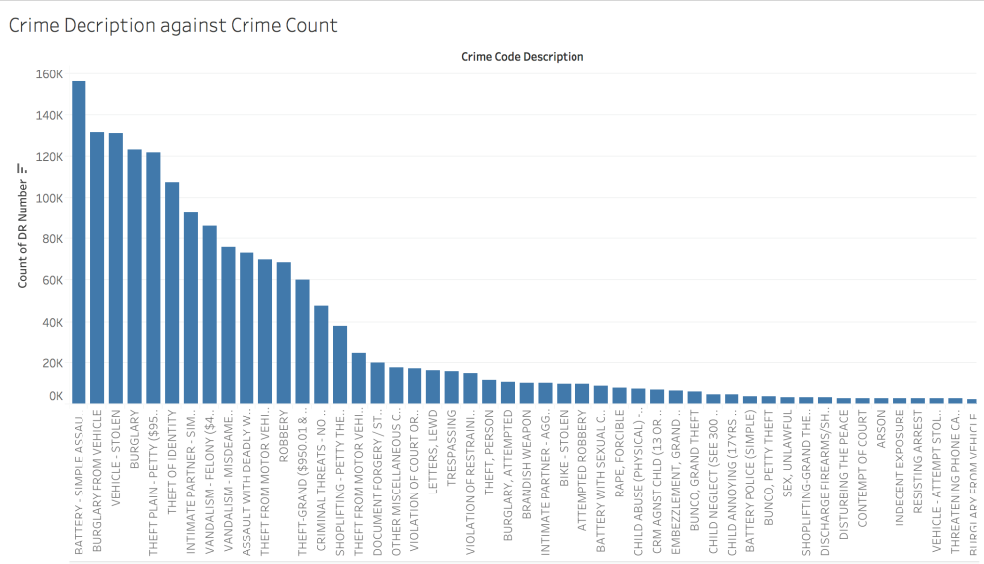
Overall Trend
Chicago
Los Angeles
New York

Slide 7
Major Challenge
Each state has it’s own definition of crime.
Uniform Crime Reporting – FBI

Slide 8
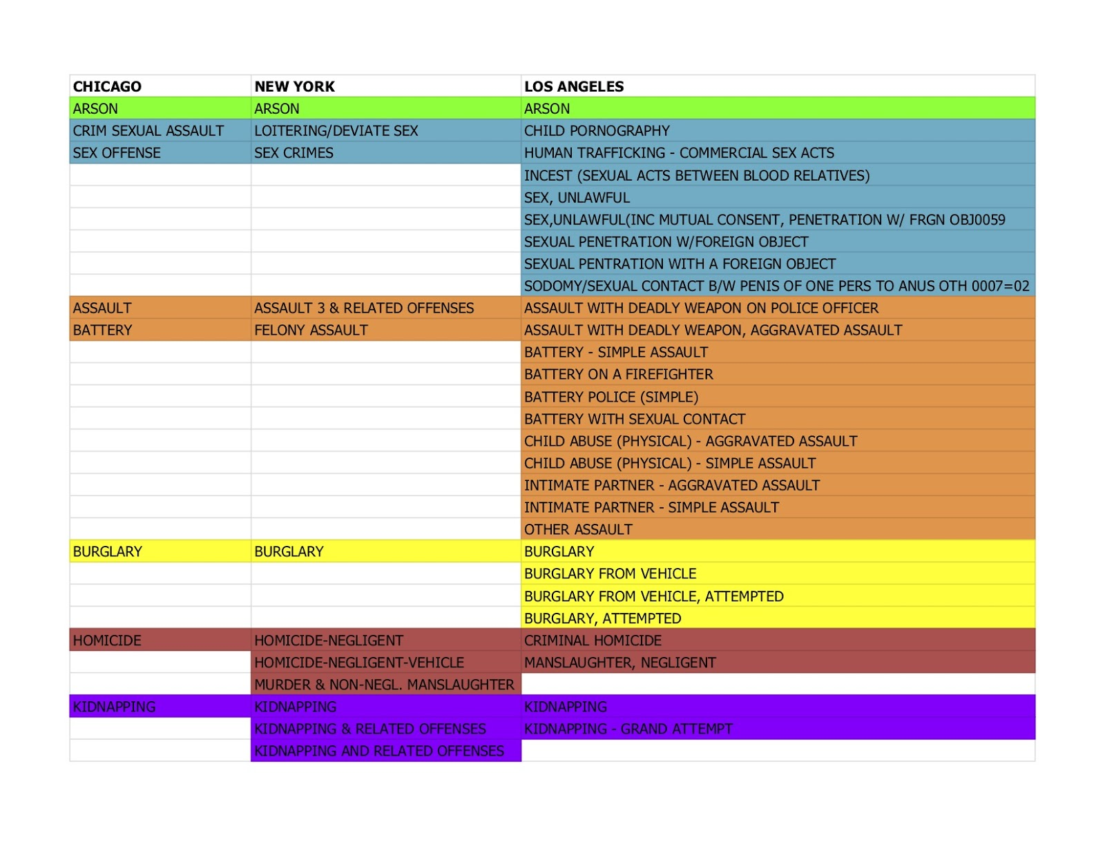
Approach to crime Comparision

Slide 9
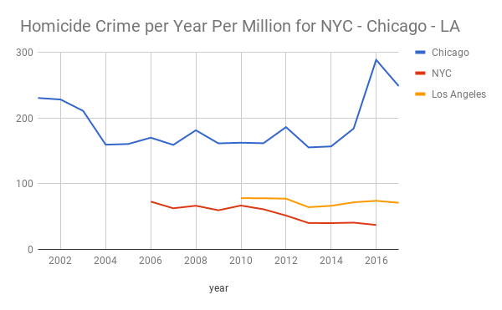
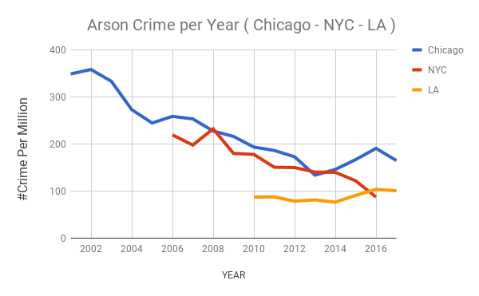

Slide 10
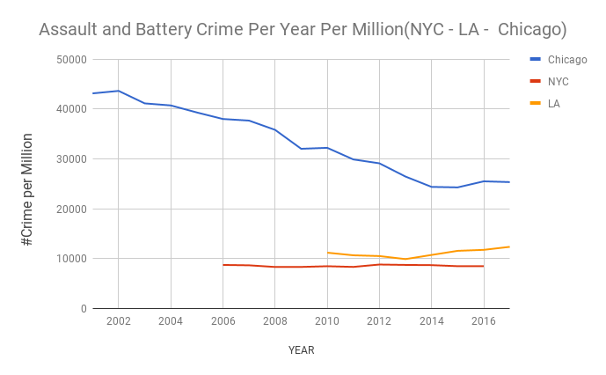
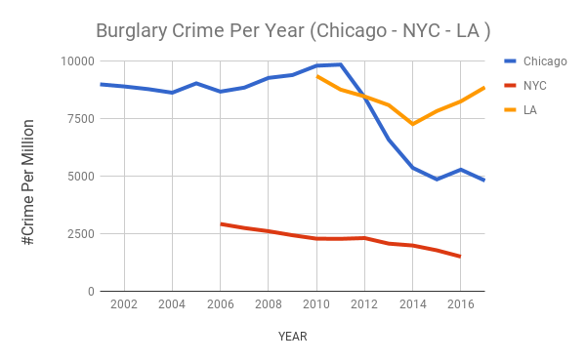

Slide 11
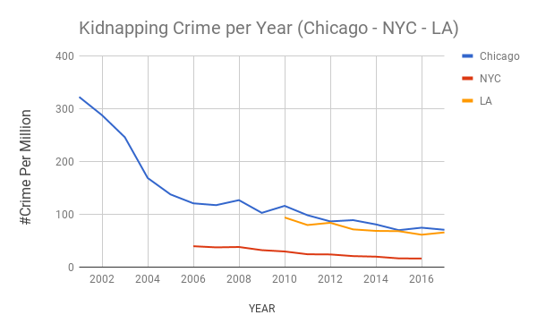
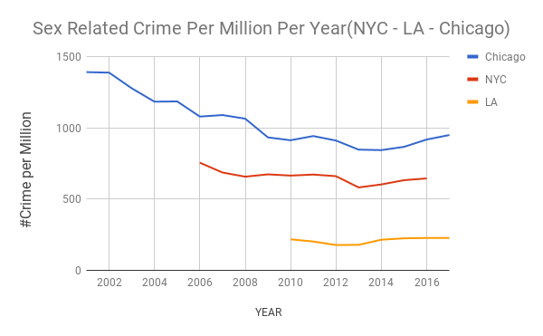

Slide 12
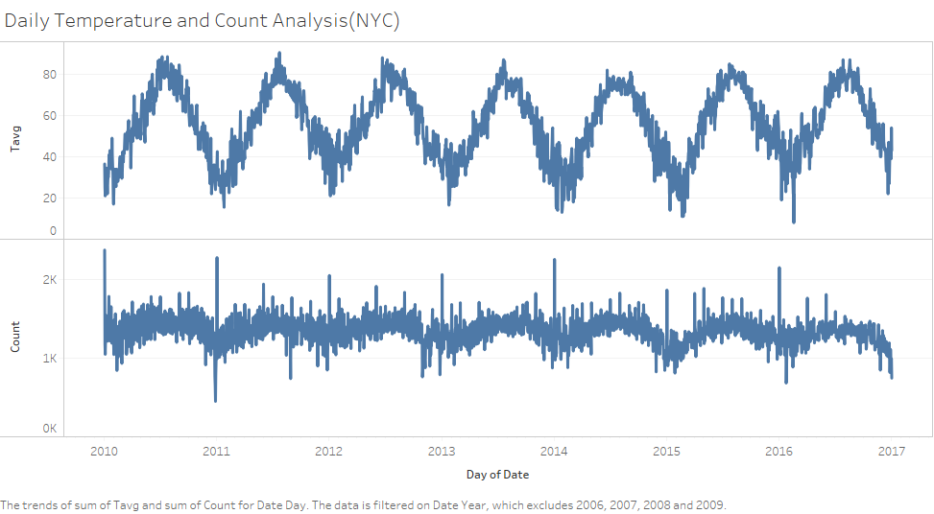
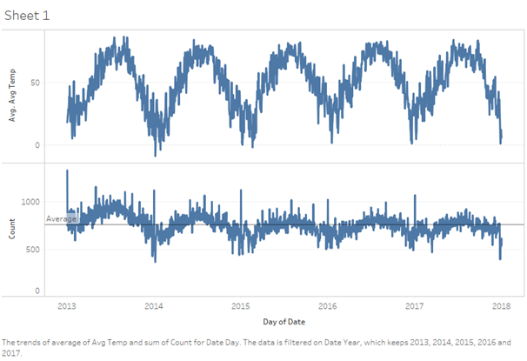
Weather & Crime –General Trend

Slide 13
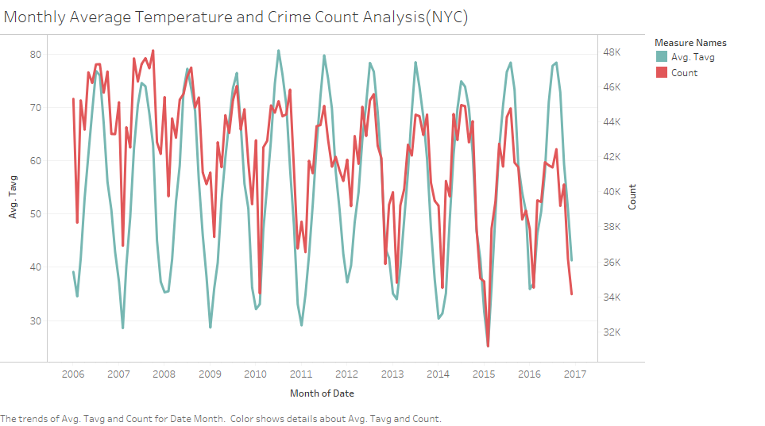
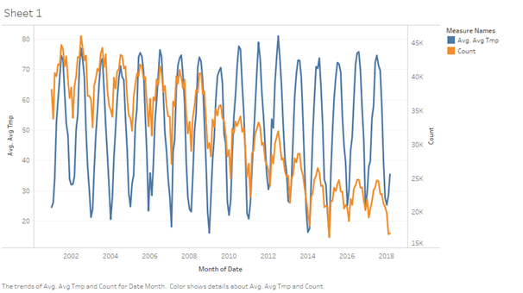
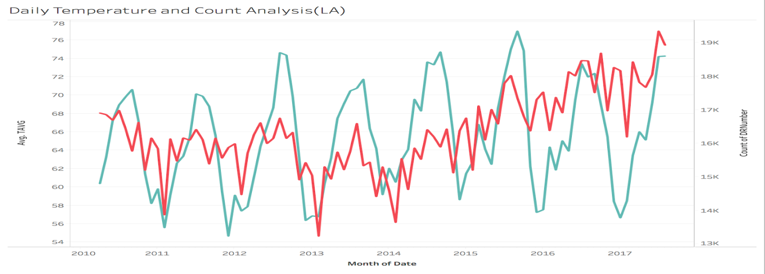
Weather &Crime - Average Temperature

Slide 14
Correlation Values – Avg. Temp.
 | Chicago | Los Angeles | New York
P-value | <0.0001 | <0.0001 | <0.0001
Pearson corr. | 0.37 | 0.152 | 0.408
Spearman corr. | 0.35 | 0.256 | 0.418

Slide 15
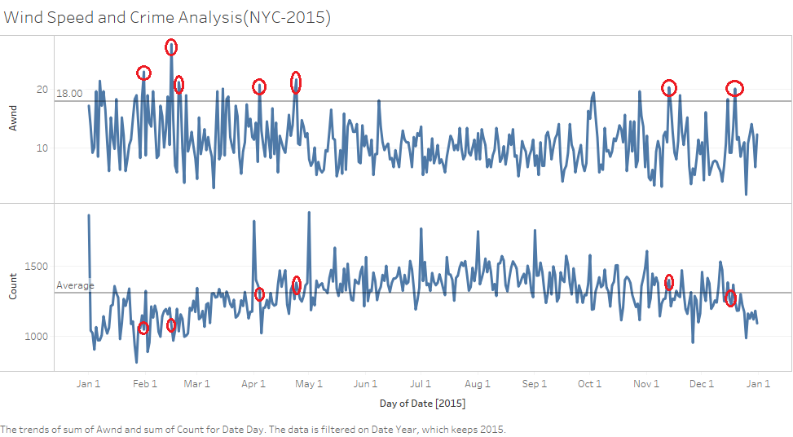
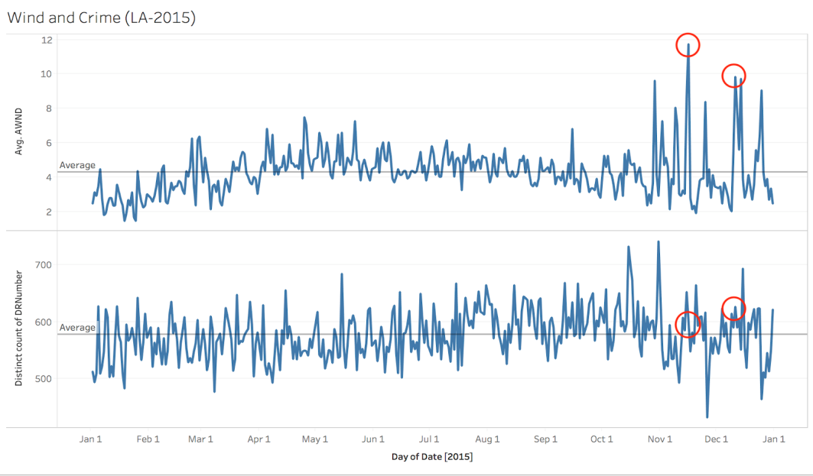
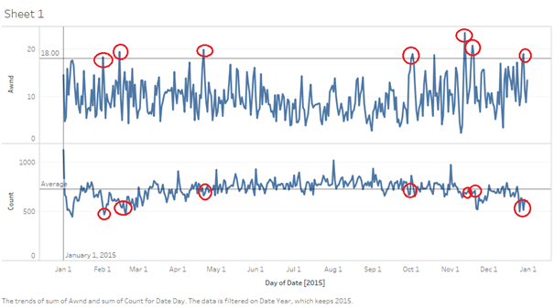
Weather And Crime – Wind Speed

Slide 16
Correlation Values – Wind Speed
 | Chicago | Los Angeles | New York
P-value | <0.0001 | <0.0001 | <0.0001
Pearson corr. | -0.156 | 0.028 | -0.208
Spearman corr. | -0.159 | 0.1028 | -0.172

Slide 17
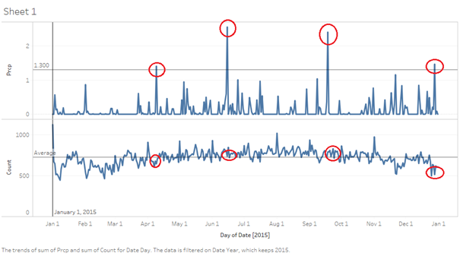
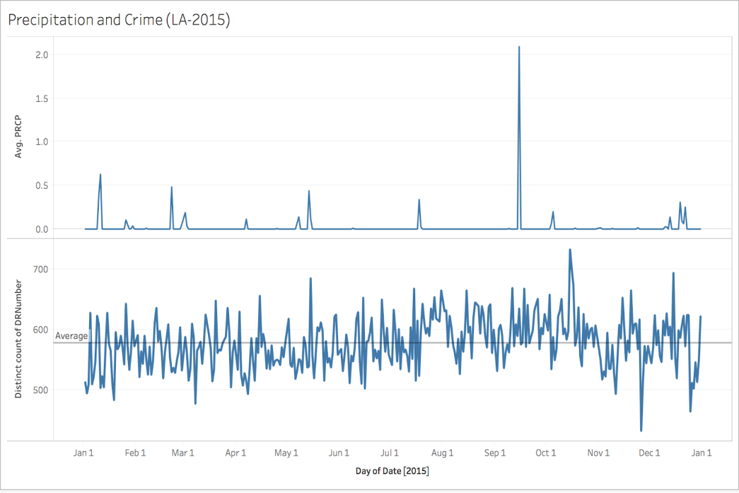
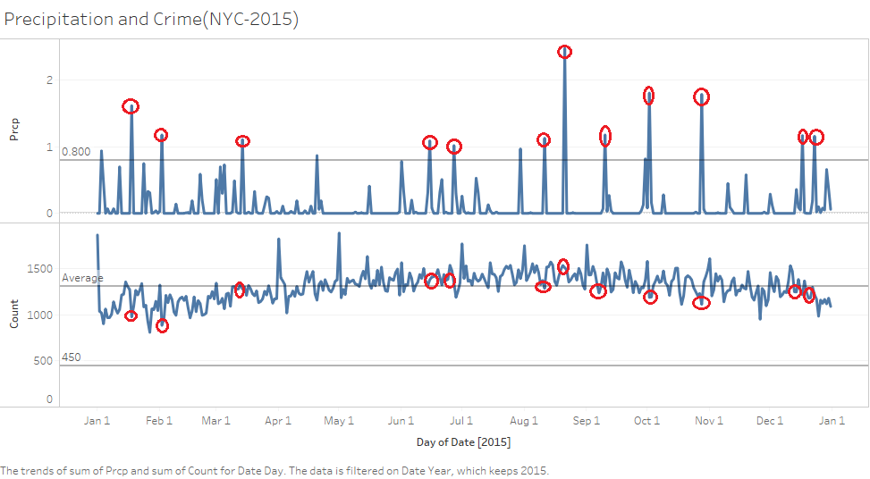
Weather &Crime –Precipitation

Slide 18
Correlation Values – Precipitation
 | Chicago | Los Angeles | New York
P-value | <0.0001 | 0.03 | <0.0001
Pearson corr. | -0.02 | -0.039 | -0.147
Spearman corr. | -0.62 | -0.04 | -0.129

Slide 19
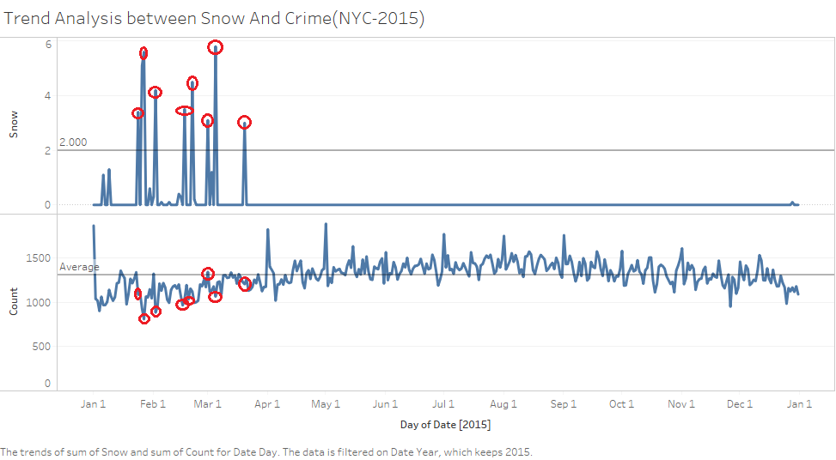
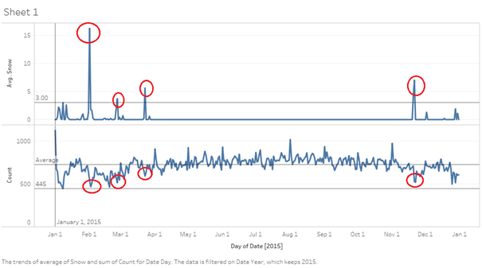
Weather &Crime –Snow
 | Chicago | New York
P-value | <0.0001 | <0.0001
Pearson corr. | -0.155 | -0.223
Spearman corr. | -0.185 | -0.218

Slide 20
Demographics and Crime (Chicago)
Parameters
Area(in sq miles)
CrimePerPop
Per Capita Income
Percent Aged 16+ Unemployed
Percent Aged 25+ Without High School Diploma
Percent Aged Under 18 Or Over 64
Percent Households Below Poverty
Percent Of Housing Crowded
Parameters
Asian(%)
Black(%)
Hispanic(%)
White(%)
Other(%)
Percent Aged Under 18 Or Over 64
Population
Median Income
Community Area Name

Slide 21
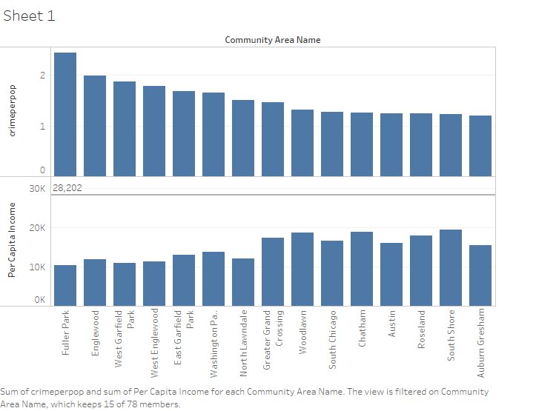
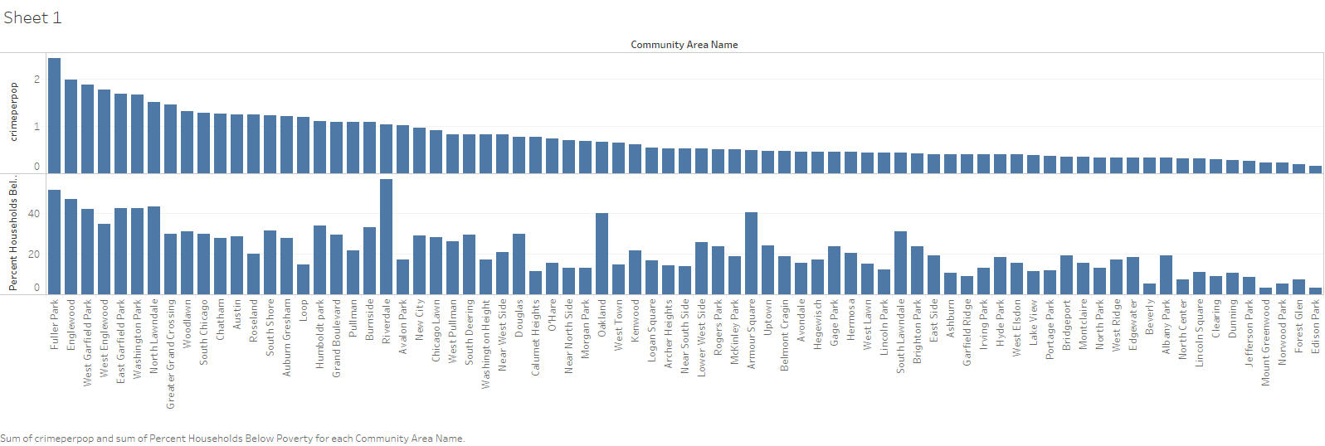
Demographics and Crime (Chicago)

Slide 22
Correlation Values
 | P-value | Pearson corr. | Spearman corr.
Per Capita Income | <0.0001 | -0.359 | -0.530
Median Income | <0.0001 | -0.486 | -0.627
Percent Households Below Poverty | <0.0001 | 0.769 | 0.775
Percent Aged 16+ Unemployed | <0.0001 | 0.787 | 0.7359
*Also significant correlation were found with population mix.

Slide 23
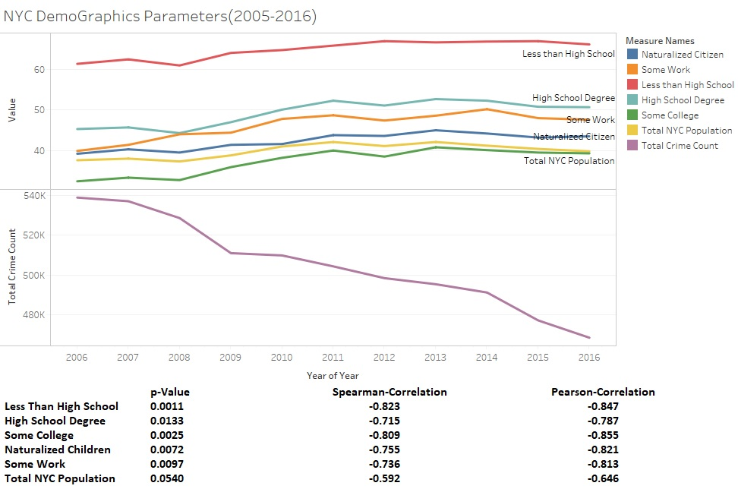
Demographics and Crime (NYC)

Slide 24
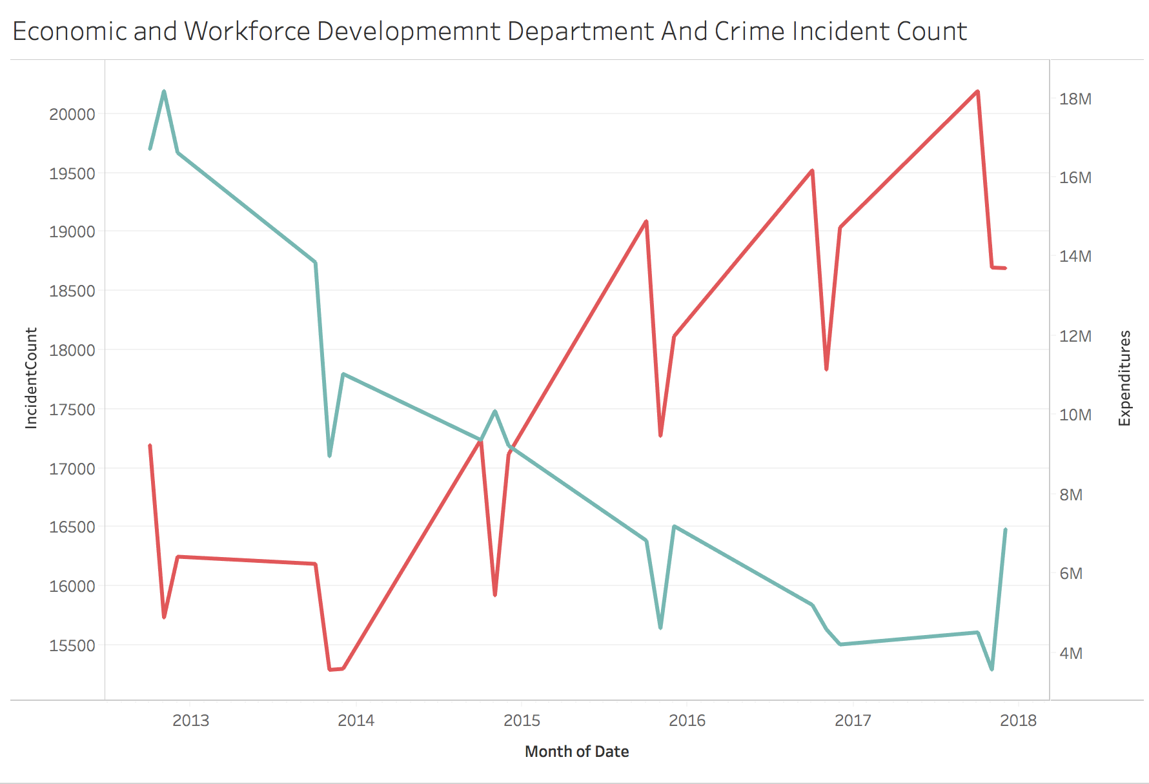
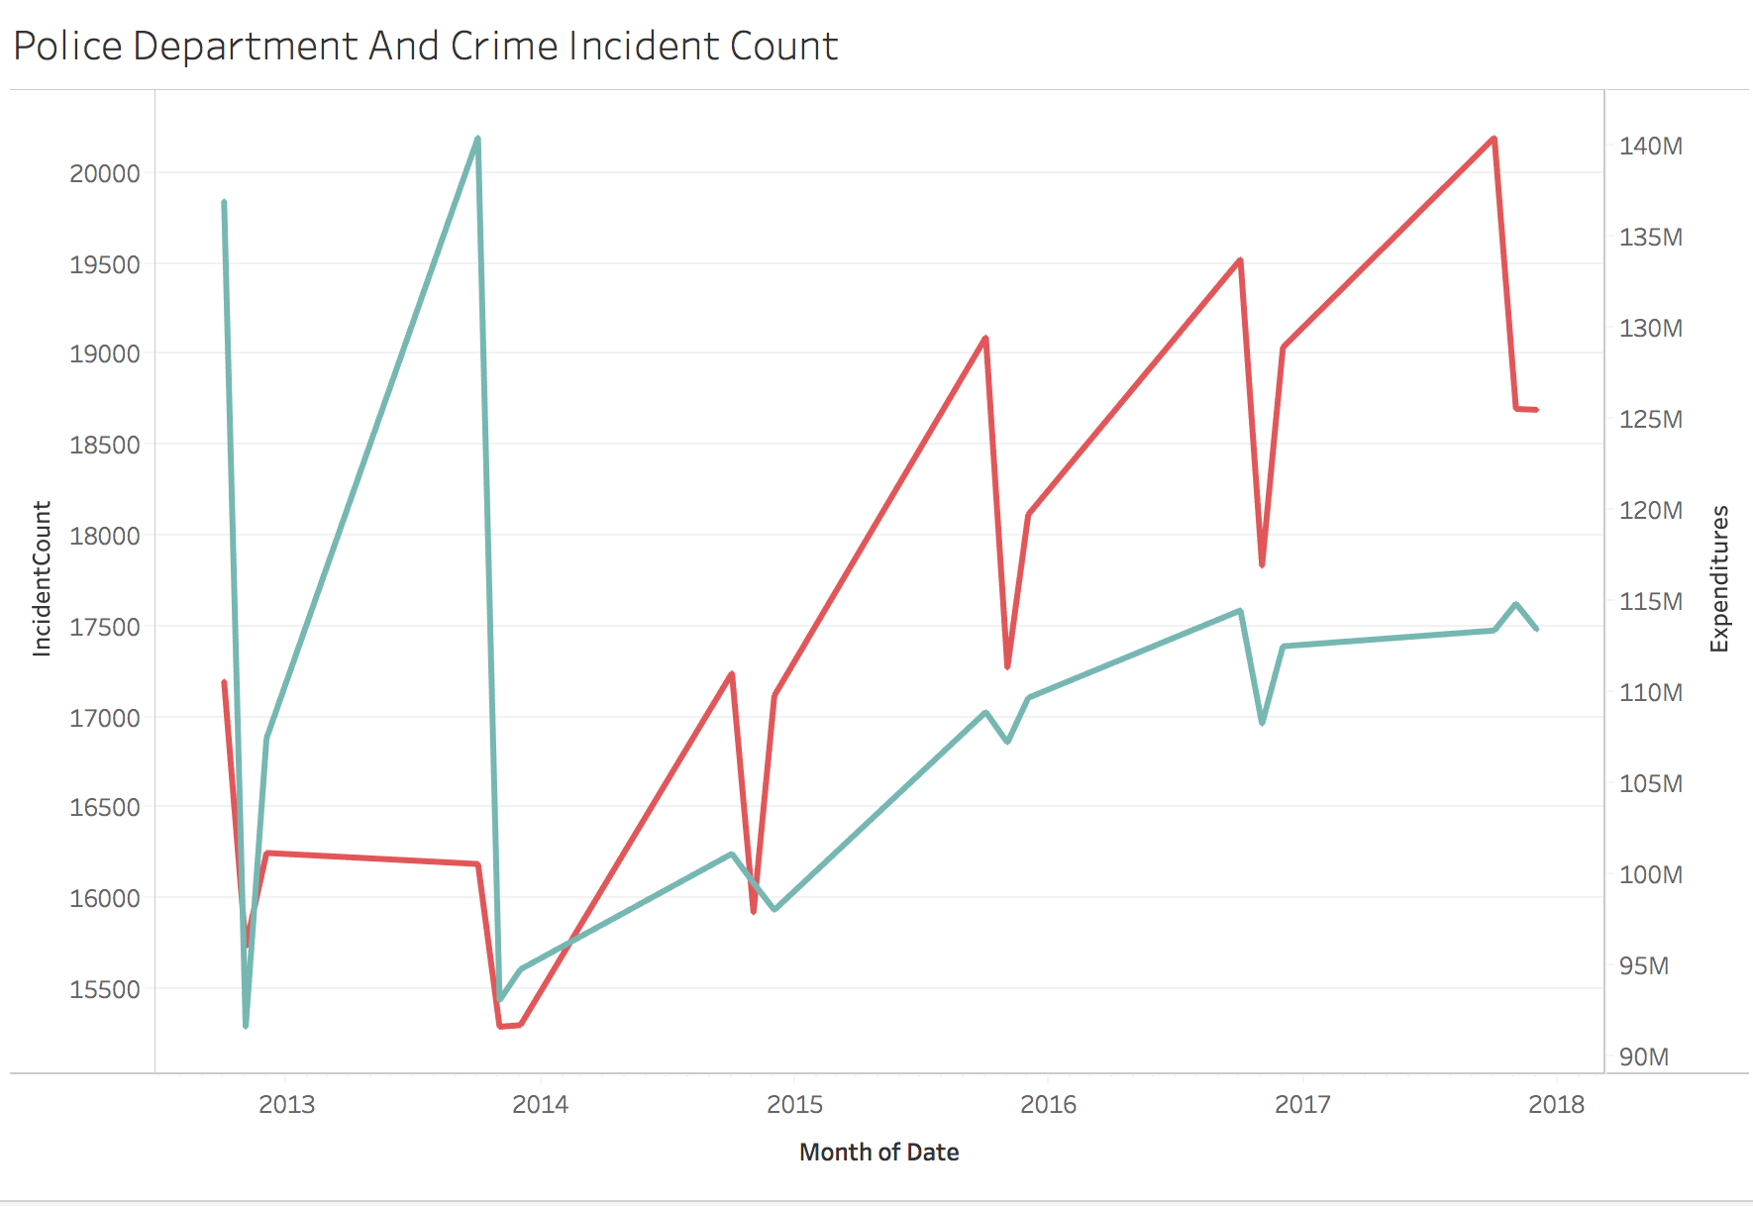
Budget and Crime (LA)

Slide 25
Budget and Crime(LA)
 | P-Value | Pearson corr | Spearmanrcorr
Econominc andWorkforce Development Department | 0.0002 | -0.685 | -0.764
Police Department | 0.006 | 0.332 | 0.616

Slide 26
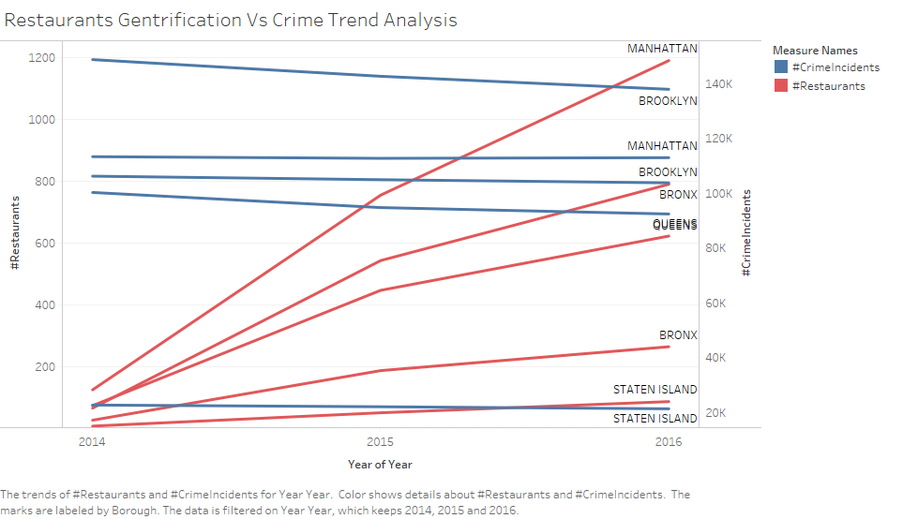
Restaurants and Crime (NYC)

Slide 27
Conclusion
After the analysis we observed that there is a clear correlation between extreme temperature, wind, snow, precipitation and crime rates.
We also observed that socio-economic factors like poverty, unemployment, education, wellness expenditure and gentrification impact crime.

Slide 28
Future Work
Gather more datasets that might affect crime.
Use machine learning to create models that could predict crime.
Apply the similar analysis to few more cities.
A granular analysis of crime dataset.

